Slide 1
The Opioid Epidemic and Naloxone CTSMA 57th Annual Conference
Ann Linskey, Pharm D, RPh
March 25, 2017

Slide 2
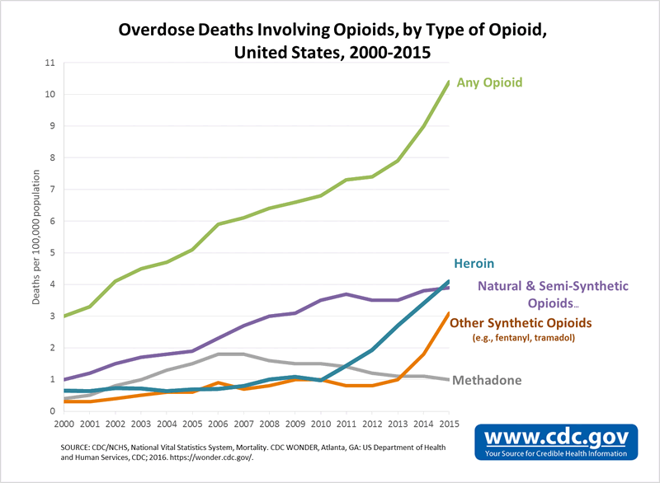

Slide 3
Connecticut Overdose Deaths
States with statistically significant increases in drug overdose death rates from 2014 to 2015 included Connecticut, Florida, Illinois, Kentucky, Louisiana, Maine, Maryland, Massachusetts, Michigan, New Hampshire, New Jersey, New York, North Carolina, Ohio, Pennsylvania, Rhode Island, Tennessee, Washington, and West Virginia
Connecticut had a 25.6% increase in drug overdose deaths from 2014 to 2015

Slide 4
The Epidemic
The majority of overdose deaths (more than 6 out of 10) involve an opioid
Since 1999, the number of overdose deaths involving opioids quadrupled
91 Americans die every day from an opioid overdose
Overdoses from prescription opioids are a major factor in the 15 year increase
From 2000-2015 more than 500,000 people died

Slide 5
Opioid Receptors
Mu(OP3)
Analgesia
Sedation
Euphoria
Respiratory depression
Constipation
Physical Dependence
Kappa(OP2)
Mild Analgesia
Sedation Disorientation)
Delta(OP1)
Mild analgesia
Sedation

Slide 6
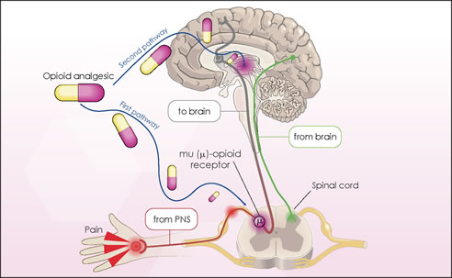
Overdose
Opioid receptors are found in the brain, including in the respiratory center in the medulla

Slide 7
Overdose
Reduced sensitivity to changes in O₂ and CO₂ outside of normal ranges
Changes in tidal volume and respiratory frequency
Opioid Overdoses Cause
White JM, Irvine RJ. Mechanism of fatal opioid overdose. Addiction. 1999 Jul;94(7):961-72.

Slide 8
Overdose
An acute condition due to excess intake of opioids
Overdose death usually occurs over 1 to 3 hours

Slide 9
Overdose
Opioids death is caused by:
Acute respiratory failure
Hypoventilation
Increased CO₂
Decreased Oxygen

Slide 10
Naloxone
An ANTIDOTE for OPIOID overdose
Naloxone is an opioid receptor antagonist at mu, kappa, and delta receptors
Works at the opioid receptor to displace opioid agonists
Shows little to no agonist activity
Shows little to no pharmacological effect, even at high doses, in patients who have not received opioids

Slide 11
Naloxone
Naloxone is an antidote for opioids only:
Fentanyl
Morphine
Buprenorphine
Hydrocodone
Hydromorphone
Codeine
Oxymorphone
Methadone
Oxycodone
Heroin

Slide 12
Pharmacology
Reverses toxic & clinical effects of opioid overdose
Reverses respiratory depression, hypotension & sedation
Restores breathing
Reverses analgesia
Patients can enter withdrawal after naloxone administration

Slide 13
Onset and Duration of Action
Naloxone takes effect in 3 to 5 minutes
If patient is not responding in this time, a second dose may need to be administered
Naloxone wears off in 30-90 minutes
Patients can go back into overdose if long acting opioids were taken. More naloxone may be necessary
Patients should avoid taking more opioids after naloxone administration so they do not go back into overdose after naloxone wears off
Patients may want to take more opioids because they may feel withdrawal symptoms

Slide 14
Side Effects
The most common adverse event is opioid withdrawal symptoms
IM & IN Naloxone do not result in withdrawal reaction
More severe adverse events are considerably less common and even when severe, less dangerous than an untreated opioid overdose

Slide 15
Available Dosage Forms
Intranasal Form (IN)
Brand Name Narcan spray
Also as 2mg/2ml prefilled syringes
-Compatible with mucosal automation device for nasal delivery
Intramuscular (IM)
Available as 0.4mg/ml solution for injection in 1ml and 10ml vials
Auto-injector (Evzio)
Intravenous (IV)
Standard antidote used by EMS for diagnosing and treating opioid

Slide 16
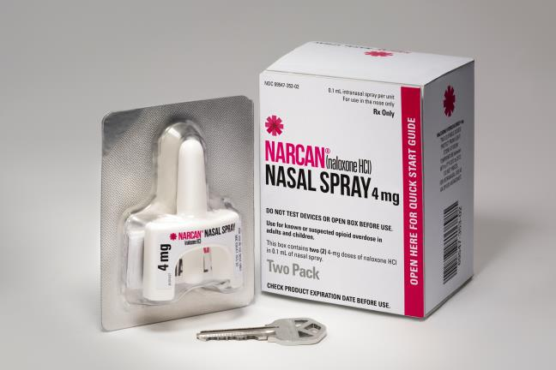
Nasal Administration (Narcan Nasal Spray)

Slide 17
Nasal administration (generic injection with atomizer)
Pros
Acceptable to non-users
No needle stick risk
No disposal concerns
Cons
Non FDA approved
Assembly required
Subject to breakage
Same onset as IM

Slide 18
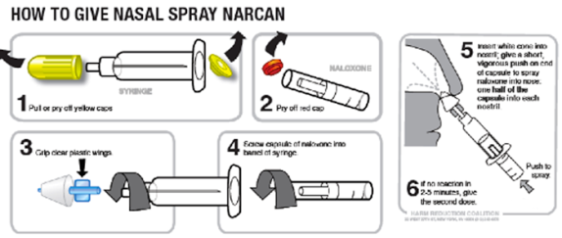

Slide 19
Why use Naloxone?
Effective, inexpensive and easy to administer
Success in take home programs facilitated by community outreach
No effects if opioids are not present
No euphoria from Naloxone
Cannot be used
Fewer barriers to access
Not scheduled or controlled

Slide 20
Access to Naloxone
Certifications
There is no special certification needed to prescribe
Law
CT law allows for anyone to be prescribed Naloxone
Can be prescribed to a family member or a friend of an at risk person
Prescribing
As of 10/1/15 pharmacist trained and certified by DCP or their approved employer can PRESCRIBE Naloxone

Slide 21
Liability
Who is responsible?
Generally associated with fewer risks than other commonly used injectable rescue medications such as epinephrine for anaphylactic shock and glucagon for hypoglycemia.
Not aware of any case in which a provider of naloxone has been subjected to a malpractice case or professional discipline.
An Act Providing Immunity to a person who administers an opioid antagonist to another person experiencing an opioid-related drug overdose”, also known as Public Act 14-61 became effective on 10/1/14.
Provides protection from civil liability and criminal prosecution to anyone administering naloxone

Slide 22
Does availability of Naloxone lead to increased drug use?
There is no data to support this claim
Drug Users can only enter treatment if they are alive
Data from a recently published study shows that for the period of 1999-2014, the adoption of Naloxone laws was associated with a 9 to 11 % reduction in opioid related deaths
Rees, et al, The Effects of Naloxone Access and Good Samaritan Laws on Opioid-Related Deaths, National Bureaus of Economic Research, February 2017

Slide 23
Thank you for all that you do!

